Slide 1
Amazon Movie recommendation by using random walk
Melih
Philip
Federico
Koray
Notes:
Hello everybody, in our project for this course we have implemented a movie recommendation system by using a random walk algorithm

Slide 2
Idea and Goals
Informal goal: Predict what movies are likely to be watched by a person given their past movie library .
Idea: In a dataset that presents reviewers and movies that has been reviewed by reviewers at time t, we will predict what movie is going to be reviewed at time t+1
Notes:
A simple way of expressing our idea, is that we will try to predict what movie a person would like to watch next.
To do this we will use data about reviewers and their movie reviews.
With this in mind the idea can be described as: we will look at a data set that represents reviewers and their personal rating of movies at time t. We will then try to predict the creation of new reviews for these same movies at time t+1. For example, Bob has reviewed Star Wars at time t, we might try and predict that he will like and review Lord of the rings at time t+1.

Slide 3
Dataset
Data content:
movieid
reviewer
time
score (1-5)
Web data: Amazon movie reviews
Size:
~8M reviews
~889K users
~253K movies
Spans a 10 year period up to 2012
Notes:
The dataset we decided to use comes from the Amazon website and it includes almost 8 million reviews spanning from 1997 and 2012. In the original dataset there is information useless for this project such as the review comment or the helpfulness of the review. In the end we extracted 4 fields which are the product ID, the reviewer ID, the time at which the review was written and the score the reviewer gave.

Slide 4
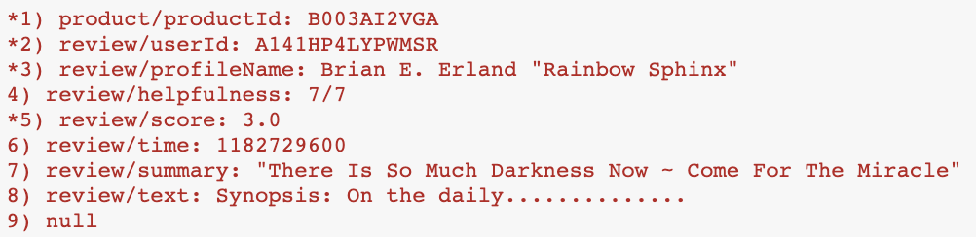
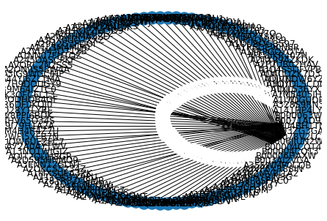
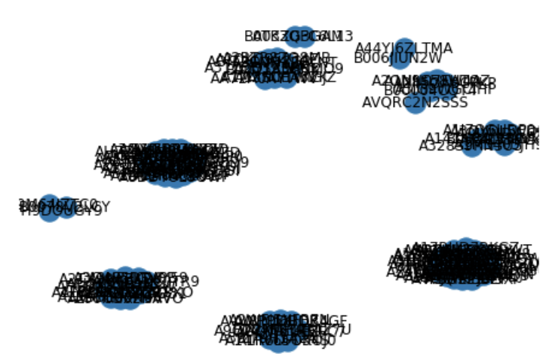
A quick glance to User-Movie Relation
for 100 movies
Sample Data:
* are parsed to use
(each movie record has 9 lines)
Notes:
In order for our data to be ready for being fed to the random walk algorithm we had to modify the structure of the graph and, as Philip will explain more in detail, extract a bipartite graph out of the original dataset. Unfortunately, we can only extract bipartite graphs out of a connected graph. This means that we took the biggest connected component in our original dataset to form our bipartite network. We ended up with a final graph of ~50k edges and ~20k nodes from which we also extracted a test set of 4k edges and 3k nodes

Slide 5
Method
Bipartite network: movies and users
Supervised random walks
Weighted edges
Beta value
Threshold value
Notes:
To predict movies for users, we create a bipartite network of the dataset at time t. The two types of nodes are movies and users. The edges of this network represent the reviews of the dataset. The edge weights are between correspond to how the review graded the movie end node. So for example, if Bob gives Monsters Inc. a good review, there will be an edge with a high weight between Bob and Monsters Inc.
To find find movie suggestions, we will then use random walk with restarts on this weighted bipartite graph. We start at the reviewer in person and then traverse with an edge with a probability proportionate to the weights of the outgoing edges. So if we are at a node with 2 outgoing edges of weight 2 and 1, we will be twice as likely to traverse over the edge with weight 2. But since we use restarts we also introduce the possibility of restarting from the first node. This is represented by the beta value. We have set the beta value to 0.15, or 15%.
In the end, the algorithm outputs the probabilities that the walk end at each user node. We then pick the users that are valued above a certain threshold and at time t+1 we pick their favorite movies.

Slide 6
Results
AUC | Threshold (%) | TPR* | FPR*
0.84 | 2 | 0.80 | 0.20
 | 4 | 0.60 | 0.08
 | 6 | 0.47 | 0.04
* TPR = True positive rate ** FPR = False positive rate
Notes:
Here is our current results with thresholds from 2 to 6 %. This is for 50K nodes at time t modeling and additional 20K nodes in time t+1. When we change those numbers, the ratios change. we tried many of them and depending of the chosen set the AUC varied from 0.7 to 0.84 but 50k/20k ratio gave .84 twice in a row.
For now, the ratio of 2.5 (50K/20K) looks good. if the t+1 set is bigger, AUC decreases. the reason is probably there are too many new users and movies involved so our modelling test set loses its value.
When the t+1 set is too few, AUC also decreases because this time there is not enough links are added in such a short time (small dataset), so the prediction is too much biased to the first dataset from time t, but gives worse results for the second at time t+1.
If we use a big set at time t, it increases the performance (50K is good).
But we couldn't test for more than 50K because of the computational limitations (not enough CPU and RAM). so, with a more powerful machine, we believe, we can achieve higher AUC values

Slide 7
Challenges
Heterogeneous graph
Temporal aspect
Parameters
Notes:
The challenge we face lays in the fact that supervised random walks has not been used for heterogeneous graphs like ours.
During development, we could also decide to remove the temporal aspect and focus on a static network.
Our objective is not to find an algorithm for one dataset but instead to get consistent results over different ones

Slide 8
Contributions
Melih: The code, theory
Philip: Theory, presentation
Koray: Theory, presentation
Federico: Theory, presentation

Slide 9
Further research
Consistency between datasets
Test other beta values

